Slide 1
VANET : Improving Routing Reliability Of AODV Protocol
Internal Guide:
Dr. Ritesh Patel
Co-Guide:
Asst. Prof. Ronak R Patel
Prepared by:
Prajesh Prajapati (23PGCE008)

Slide 2
COMMENTS
External Comments
Improve Understanding of wired and wireless network
Proposed work consider new model vehicle. Perform experiment on simulation.
Analysis of existing wires and use of AODV with vehicular network.
Internal Comments
Improve understanding of route discovery and functionality of Aodv.
Include more simulation scenarios, speed, vehicles.

Slide 3
OUTLINE
Introduction
Literature survey
Research Gap & Motivation
Algorithm
Simulation Setup
Results and Graphs
Conclusion
Future Work
References

Slide 4
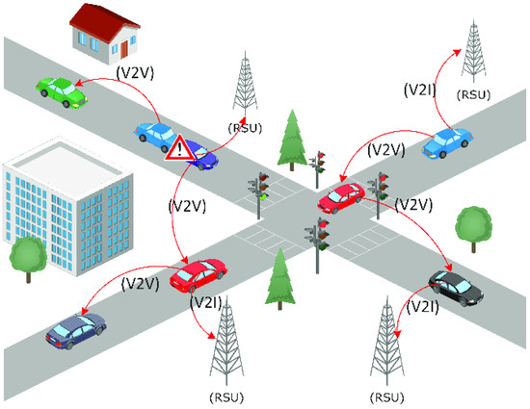
INTRODUCTION

Slide 5
INTRODUCTION
VANETs enable vehicle-to-vehicle (V2V) and vehicle-to-infrastructure (V2I) communication, crucial for Intelligent Transportation Systems (ITS).
They support collision avoidance, traffic updates, route optimization, and emergency response.
Challenges: High mobility, frequent link failures, and rapid topology changes degrade routing performance.
AODV widely used reactive routing protocol, perform poorly in VANETs due to its static nature.

Slide 6
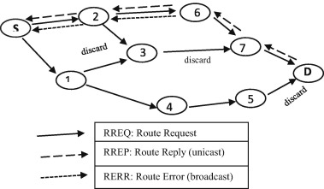
AODV Protocol

Slide 7
APPLICATIONS
Safety Applications
Traffic Management
Platooning
Emergency & Roadside Assistance

Slide 8
Literature Survey
Research Paper | Technique Used | Key Points | Limitation
Performance Study of AODV Protocol with Ant Colony Algorithm in VANETs [1] , 2019 | Ant Colony Optimization | Route Construction and Trail Updating, Backup Routing Mechanism | Throughput of new-AODV is decrease, Can’t provide detail analysis of overhead.
Improving AODV with TOPSIS Algorithm and Fuzzy Logic in VANETs [2] , 2019 | TOPSIS algorithm, Fuzzy algorithm | Neighbor Selection, Path Discovery, Routing Selection | less no of nodes, Inaccuracies in parameter affect the overall performance (speed, signal strength, congestion, delay).
Modifications of AODV protocol for VANETs: performance analysis in NS-3 simulator [3] , 2019 | PAODV, Nb-AODV | Find Average number of neighbor, Nb-AODV solve broadcasting RREQ request to neighbor | The number of node increase the PDR, packet loss rate and some other parameter is decrease, It will affect the performance.
Performance analysis of AODV and EDAODV routing protocol under congestion control in VANETs [4] , 2018 | EDAODV | Route Discovery, Early Congestion Detection, Bidirectional Path Discovery. | Throughput of EDAODV is less, Conduct research on 24 nodes.
End-to-End Delay Enhancement with Ring Cluster AODV in VANET [5] , 2020 | TM-AODV | Cluster Formation, Route Discovery, Gateway Node | Maintaining cluster is difficult because of high mobility, Ensuring cluster head and Gateway node in the network.
Enhancement AODV Routing Protocol at the VANET within an Urban Scenario [6] , 2023 | - | Path Discovery, Next Hop Selection, ack to Source node. | The number of node increase then the overhead is increase in propose model.
A new AODV based forecasting link breakage indicator for VANETs [7] , 2019 | LBFI | Path Discovery, LBFI indicator | High Node density impact on the performance of protocol, Using this algorithm routing overhead increase.
The Development of a Routing protocols based on Reverse-AODV by considering an energy threshold in VANET [8] , 2021 | R-AODV | Path Discovery, Threshold Energy ,Minimum Threshold Energy, R-REQ | Using this algorithm the PDR is unstable, Increase routing Overhead.
Enhanced New Clustering Ant Colony Optimization based Routing Protocol AODV-R [9] , 2017 | AODV-R, Clustering, ACO | Clustering, Ant colony Optimization | Velocity increase then packet loss rate in increase, Conduct research on 10 of nodes.

Slide 9
Performance Study of AODV Protocol with Ant Colony Algorithm in VANETs [1]
The forward ant message
The backward ant message
Route Construction and Trail Updating
Backup Routing Mechanism
Limitation:
PDR, Packet loss is improve compare to AODV protocol , but throughput of new-AODV is decrease.
Can’t provide detail analysis of overhead.

Slide 10
Improving AODV with TOPSIS Algorithm and Fuzzy Logic in VANETs [2]
Neighbor Selection
Choose neighbor based on TOPSIS Algorithm parameters: Speed, Received signal strength, congestion and average delay.
Path Discovery
Send request to reliable neighbors
Routing Selection
Fuzzy logic for choose best path consider parameter are: delay, number of hops and route validity.
Limitation:
Conduct research on less no of nodes.
Inaccuracies in parameter affect the overall performance (speed, signal strength, congestion, delay)

Slide 11
Modifications of AODV protocol for VANETs: performance analysis in NS-3 simulator [3]
PAODV
First find Average number of neighbor then calculate probability, weather it is dense or sparse network.
Nb-AODV
Each node know the neighbors, find out probability given by them.
If neighbor number higher, probability is lower and vice versa.
Based on the broadcasting RREQ request, it solve to find average number of neighbors.
Limitation:
The number of node increase the PDR, packet loss rate and some other parameter is decrease, It will affect the performance.

Slide 12
Performance analysis of AODV and EDAODV routing protocol under congestion control in VANETs [4]
Route Discovery
RREQ and RREP also send alternate path table.
Early Congestion Detection
More number of packet incoming, exceeding buffer capacity.
Bidirectional Path Discovery
BIRREQ to previous, next node and nearest node. If free node Path is start otherwise same path is follow.
Limitation:
Throughput of EDAODV is less because it take much time to receive by destination and bidirectional nature.
Conduct research on 24 nodes, In dense network it perform good or not.

Slide 13
End-to-End Delay Enhancement with Ring Cluster AODV in VANET [5]
Cluster Formation
Nodes are grouped in cluster and choose Cluster Head (managing communication Within Cluster).
Route Discovery
Gateway Node
Communication between clusters.
Limitation:
Maintaining cluster is difficult because of high mobility.
Ensuring cluster head and Gateway node in the network.

Slide 14
Enhancement AODV Routing Protocol at the VANET within an Urban Scenario [6]
Path Discovery
Broadcast RREQ in Squared section road, follow graph structure
Next Hop Selection
Road Section interaction points
If packet is received send ack to Source node.
Limitation:
The number of node increase then the overhead is increase in propose model.

Slide 15
A new AODV based forecasting link breakage indicator for VANETs [7]
Path Discovery
LBFI indicator
Early throw RERR message, source initiate next route finding.
OFDM decoding errors. (signal to noise ratio, signal strength)
Limitation:
High Node density impact on the performance of protocol.
Using this algorithm routing overhead increase.

Slide 16
The Development of a Routing protocols based on Reverse-AODV by considering an energy threshold in VANET [8]
Path Discovery
Based on energy threshold and minimum residual energy.
R-RREQ
Destination to source R-RREQ send, multiple path and reduce link breakage chance.
Limitation:
Using this algorithm the PDR is unstable.
Increase routing Overhead.

Slide 17
Enhanced New Clustering Ant Colony Optimization based Routing Protocol AODV-R [9]
Clustering
Refuse data in certain area, create cluster and cluster head.
Ant colony Optimization
Help to find out shortest path.
Limitation:
Velocity increase then packet loss rate in increase.
Conduct research on 10 of nodes, nothing provide on dense network.

Slide 18
RESEARCH GAP & MOTIVATION
Research Gaps in Existing Protocols
Frequent route breakages
High routing overhead
Poor performance in high-mobility VANETs
Motivation
Improve route stability using dynamic, context-aware metrics.
Reduce unnecessary route rediscoveries and packet loss.
Achieve better performance in dense and fast-changing environments.
Support intelligent routing needed for smart transportation systems.

Slide 19
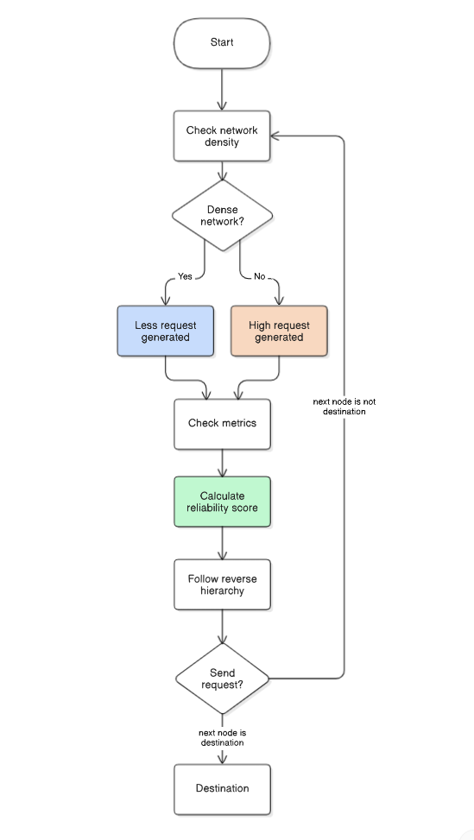
ALGORITHM

Slide 20
ALGORITHM
The proposed R-AODV protocol enhances traditional AODV by integrating three key strategies:
Density-Aware RREQ Generation:
Adjusts route request frequency based on local node density:
Formula: P=1/Nb
High density → fewer RREQs
Low density → more RREQs
2. Reliability Score-Based Route Selection:
Use weighted scores to prioritize stable neighbors.
3. Reverse hierarchical forwarding to prioritize stable paths.

Slide 21
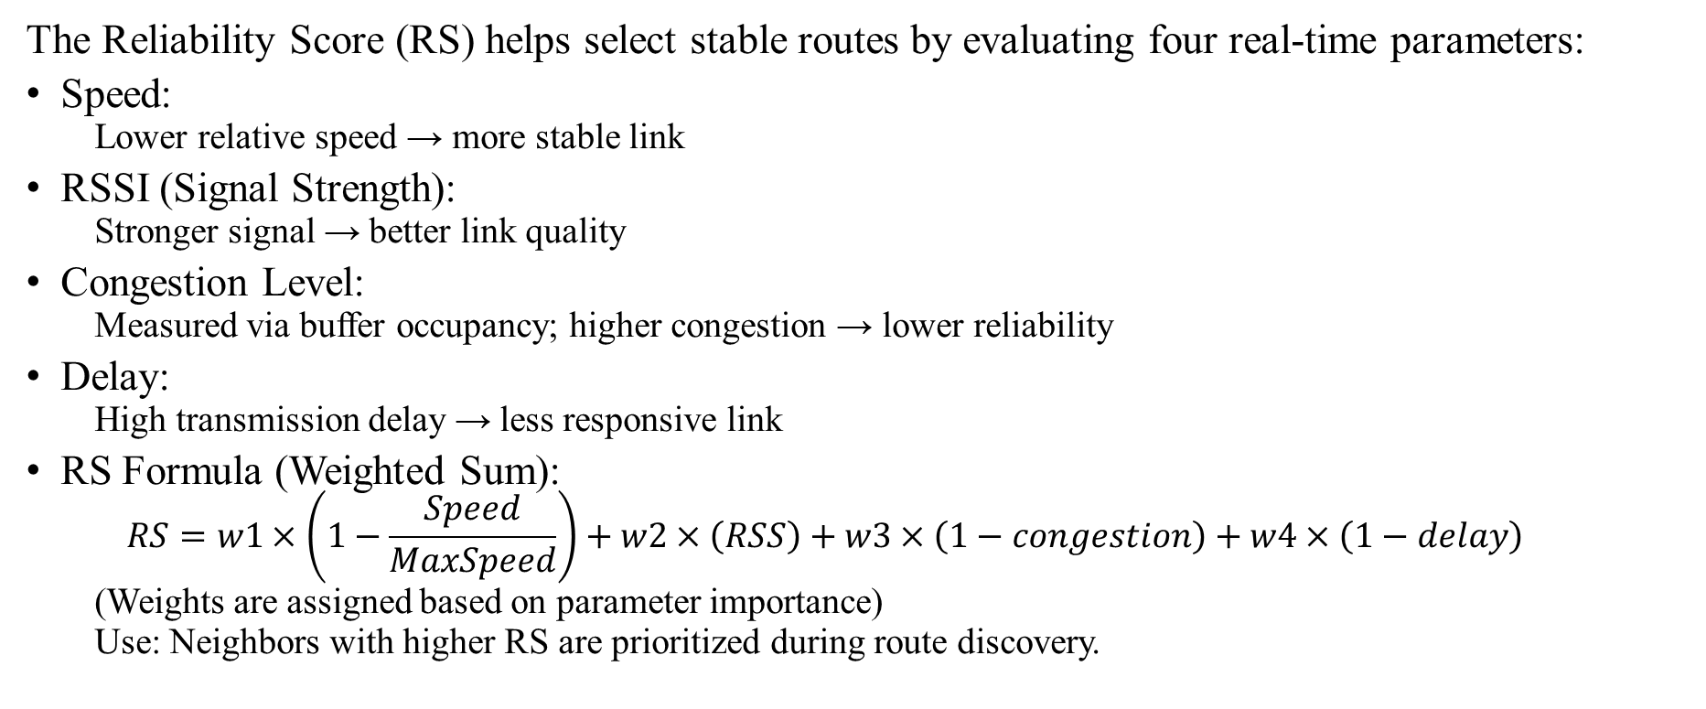
RELIABILITY SCORE PARAMETER
The Reliability Score (RS) helps select stable routes by evaluating four real-time parameters:
Speed:
Lower relative speed → more stable link
RSSI (Signal Strength):
Stronger signal → better link quality
Congestion Level:
Measured via buffer occupancy; higher congestion → lower reliability
Delay:
High transmission delay → less responsive link
RS Formula (Weighted Sum):
$$RS=w1×\left(1−\frac{Speed}{MaxSpeed}\right)+w2×\left(RSS\right)+w3×\left(1−congestion\right)+w4×\left(1−delay\right)$$
(Weights are assigned based on parameter importance)
Use: Neighbors with higher RS are prioritized during route discovery.

Slide 22
REVERSE HIERARCHICAL FORWARDING
Concept:
Instead of broadcasting Route Requests (RREQs) to all neighbors equally, R-AODV prioritizes forwarding through nodes with higher Reliability Scores (RS).
How It Works:
Neighbors are ranked based on their RS (calculated using speed, RSS, delay, congestion).
RREQs are forwarded first through the most reliable nodes, improving the chances of finding a stable path quickly.
Benefits:
Reduces route breakages
Speeds up route discovery
Lowers network overhead by limiting unnecessary broadcasts

Slide 23
SIMULATION SETUP
Tools Used:
Simulator: NS-3.38
Mobility Model: SUMO + Ns2MobilityHelper
Environment Settings:
Area: 1000m × 1000m (Urban Grid)
Vehicles: 25, 50, 75, 100
Speed Range: 30–60 km/h
Simulation Time: 300 seconds
Performance Metrics:
Packet Delivery Ratio (PDR)
End-to-End Delay
Routing Overhead
Throughput

Slide 24
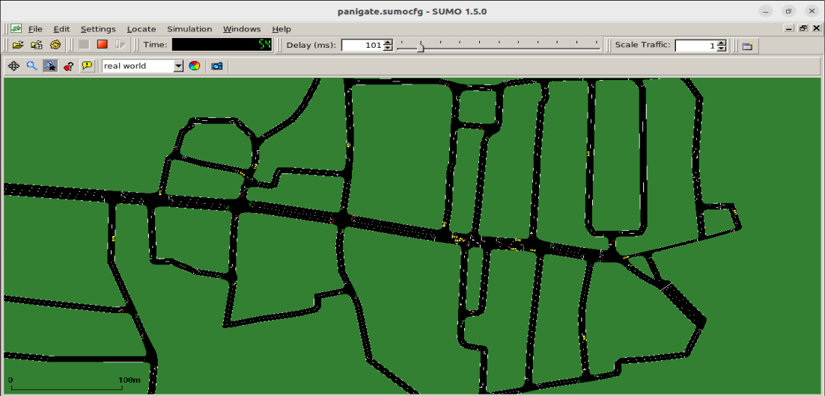
SIMULATION SETUP

Slide 25
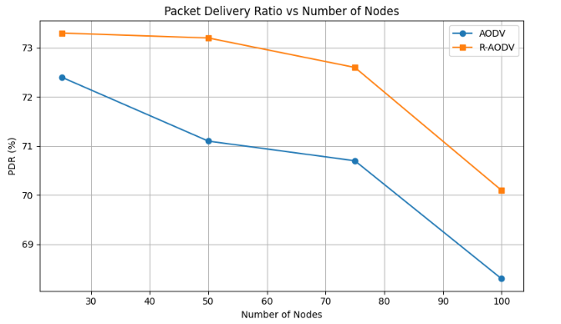
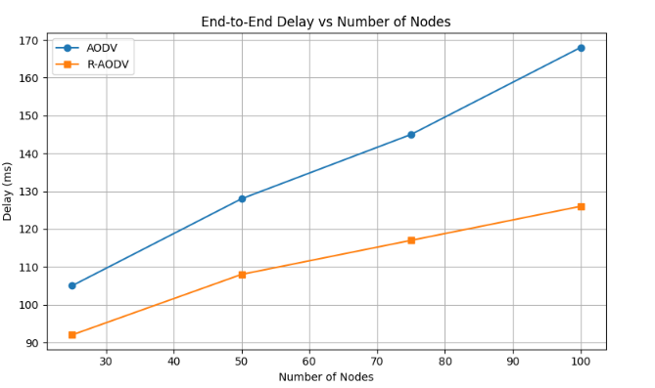
RESULTS AND GRAPHS
Packet Delivery Ratio
End-to-End Delay

Slide 26
RESULTS AND GRAPHS
Protocol | Scenario 1 | Scenario 2 | Scenario 3 | Scenario 4
AODV | 72.4 | 71.1 | 70.7 | 68.3
RAODV | 73.3 | 73.2 | 72.6 | 70.1
Packet Delivery Ratio
Protocol | Scenario 1 | Scenario 2 | Scenario 3 | Scenario 4
AODV | 105 | 128 | 145 | 168
RAODV | 92 | 108 | 117 | 126
End-to-End Delay

Slide 27
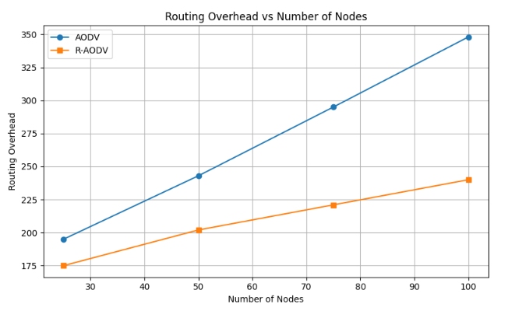
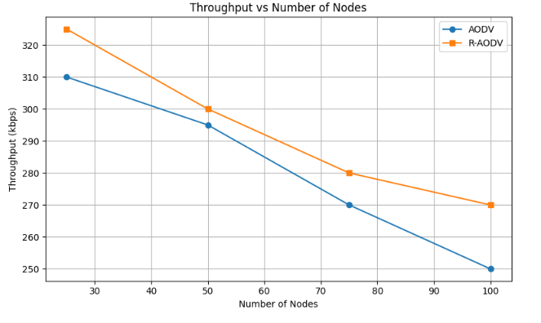
RESULTS AND GRAPHS
Routing Overhead
Throughput

Slide 28
RESULTS AND GRAPHS
Protocol | Scenario 1 | Scenario 2 | Scenario 3 | Scenario 4
AODV | 195 | 243 | 295 | 348
RAODV | 175 | 202 | 221 | 240
Routing Overhead
Protocol | Scenario 1 | Scenario 2 | Scenario 3 | Scenario 4
AODV | 310 | 295 | 270 | 250
RAODV | 325 | 300 | 280 | 270
Throughput

Slide 29
CONCLUSION
The proposed R-AODV protocol enhances routing in VANETs by using real-time metrics like speed, RSSI, congestion, and delay to select more reliable paths. Compared to standard AODV, it achieves higher packet delivery, lower delay, reduced overhead, and better throughput. These improvements make R-AODV more effective for dynamic, high-density vehicular environments, enabling more stable and efficient communication in intelligent transportation systems.

Slide 30
FUTURE WORK
Integrate Machine Learning to predict link stability using mobility and traffic patterns.
Optimize for Energy Efficiency, especially for electric and autonomous vehicles.
Explore Hybrid Routing combining topology-based and position-based strategies for better scalability.

Slide 31
References
Y. Li, Y. Liu and K. Shi, "Performance Study of AODV Protocol with Ant Colony Algorithm in VANETs," 2019 IEEE 9th International Conference on Electronics Information and Emergency Communication (ICEIEC), Beijing, China, 2019, pp. 1-4, doi: 10.1109/ICEIEC.2019.8784494. [1]
E. Amiri and R. Hooshmand, "Improving AODV with TOPSIS Algorithm and Fuzzy Logic in VANETs," 2019 27th Iranian Conference on Electrical Engineering (ICEE), Yazd, Iran, 2019, pp. 1367-1372, doi: 10.1109/IranianCEE.2019.8786427. [2]
P. D. Bugarcic, M. Z. Malnar and N. J. Jevtic, "Modifications of AODV protocol for VANETs: performance analysis in NS-3 simulator," 2019 27th Telecommunications Forum (TELFOR), Belgrade, Serbia, 2019, pp. 1-4, doi: 10.1109/TELFOR48224.2019.8971283. [3]
P. Sailaja, B. Ravi and T. Jaisingh, "Performance Analysis of AODV and EDAODV Routing Protocol Under Congestion Control in VANETs," 2018 Second International Conference on Inventive Communication and Computational Technologies (ICICCT), Coimbatore, India, 2018, pp. 945-948, doi: 10.1109/ICICCT.2018.8473050. [4]
R. Sharma and A. Chaudhary, "End-to-End Delay Enhancement with Ring Cluster AODV in VANET," 2020 3rd International Conference on Emerging Technologies in Computer Engineering: Machine Learning and Internet of Things (ICETCE), Jaipur, India, 2020, pp. 1-10, doi: 10.1109/ICETCE48199.2020.9091746. [5]
Dhari Ali Mahmood , A. A. H. (2023). Enhancement AODV Routing Protocol at the VANET within an Urban Scenario. International Journal on Recent and Innovation Trends in Computing and Communication, 11(9), 5162–5168. Retrieved from https://ijritcc.org/index.php/ijritcc/article/view/10240 [6]
S. Bourebia, B. Hilt, F. Drouhin and P. Lorenz, "A New AODV Based Forecasting Link Breakage Indicator for VANETs," 2019 IEEE Global Communications Conference (GLOBECOM), Waikoloa, HI, USA, 2019, pp. 1-6, doi: 10.1109/GLOBECOM38437.2019.9013385. [7]
N. G. Razafindrobelina, R. Anggoro and A. M. Shiddiqi, "The development of a routing protocol based on Reverse-AODV by considering an energy threshold in VANET," 2021 IEEE International IOT, Electronics and Mechatronics Conference (IEMTRONICS), Toronto, ON, Canada, 2021, pp. 1-7, doi: 10.1109/IEMTRONICS52119.2021.9422592. [8]
Singh, Harmanjot & Singh, Pahulpreet. (2017). Enhanced New Clustering Ant Colony Optimization based Routing Protocol AODV-R. International Journal of Computer Applications. 160. 24-28. 10.5120/ijca2017913099. [9]

Slide 32
Thank You

